Slide 1

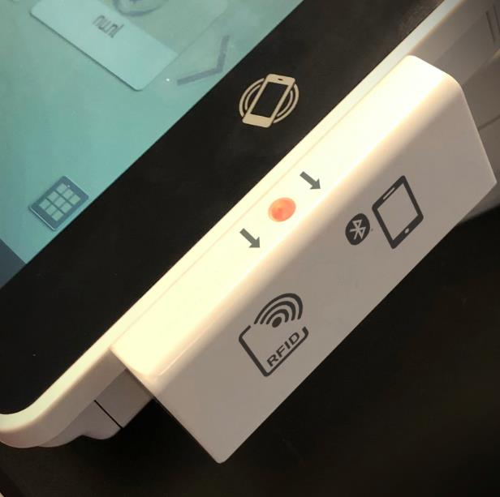
rf IDEAS new WAVE ID® Gen2.5 SOP reader launch
Ashik Ramkalawon, Channel Account Manager, rf IDEAS
Jim Garlington, Director of Sales Americas, rf IDEAS
September 2020

Slide 2
New Product Introduction
WAVE ID® Ricoh Universal SOP Reader

Slide 3

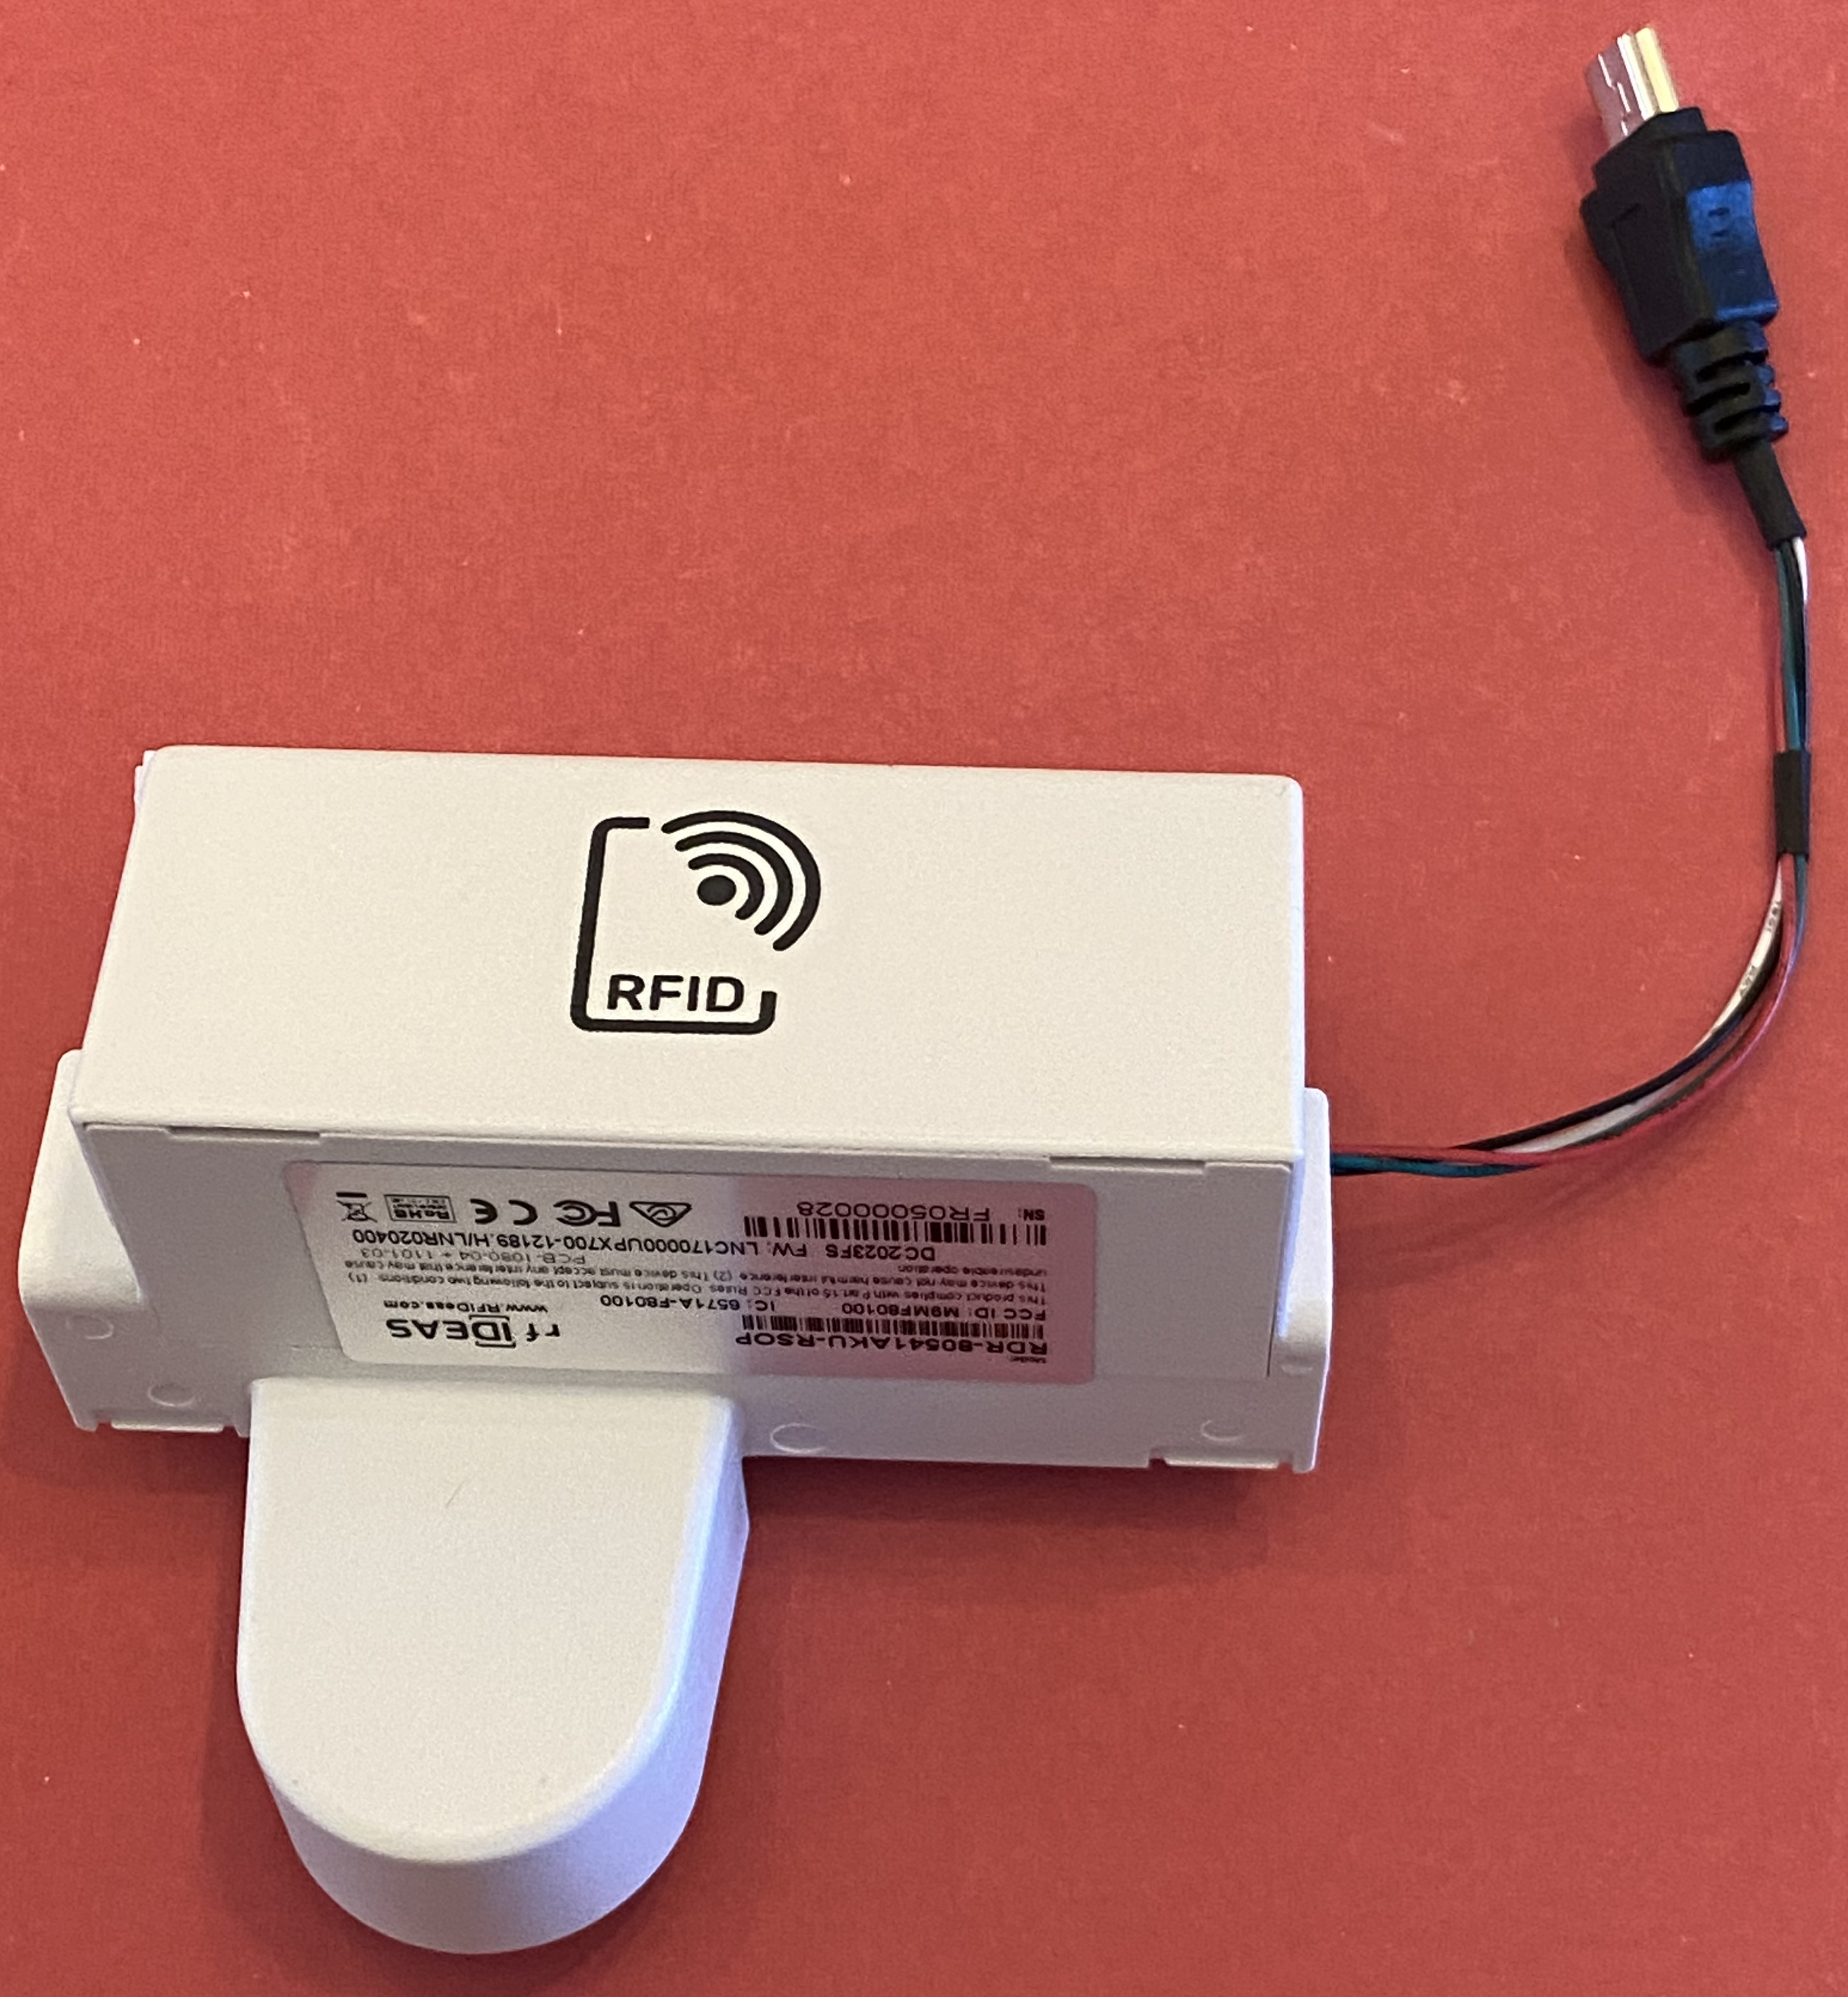
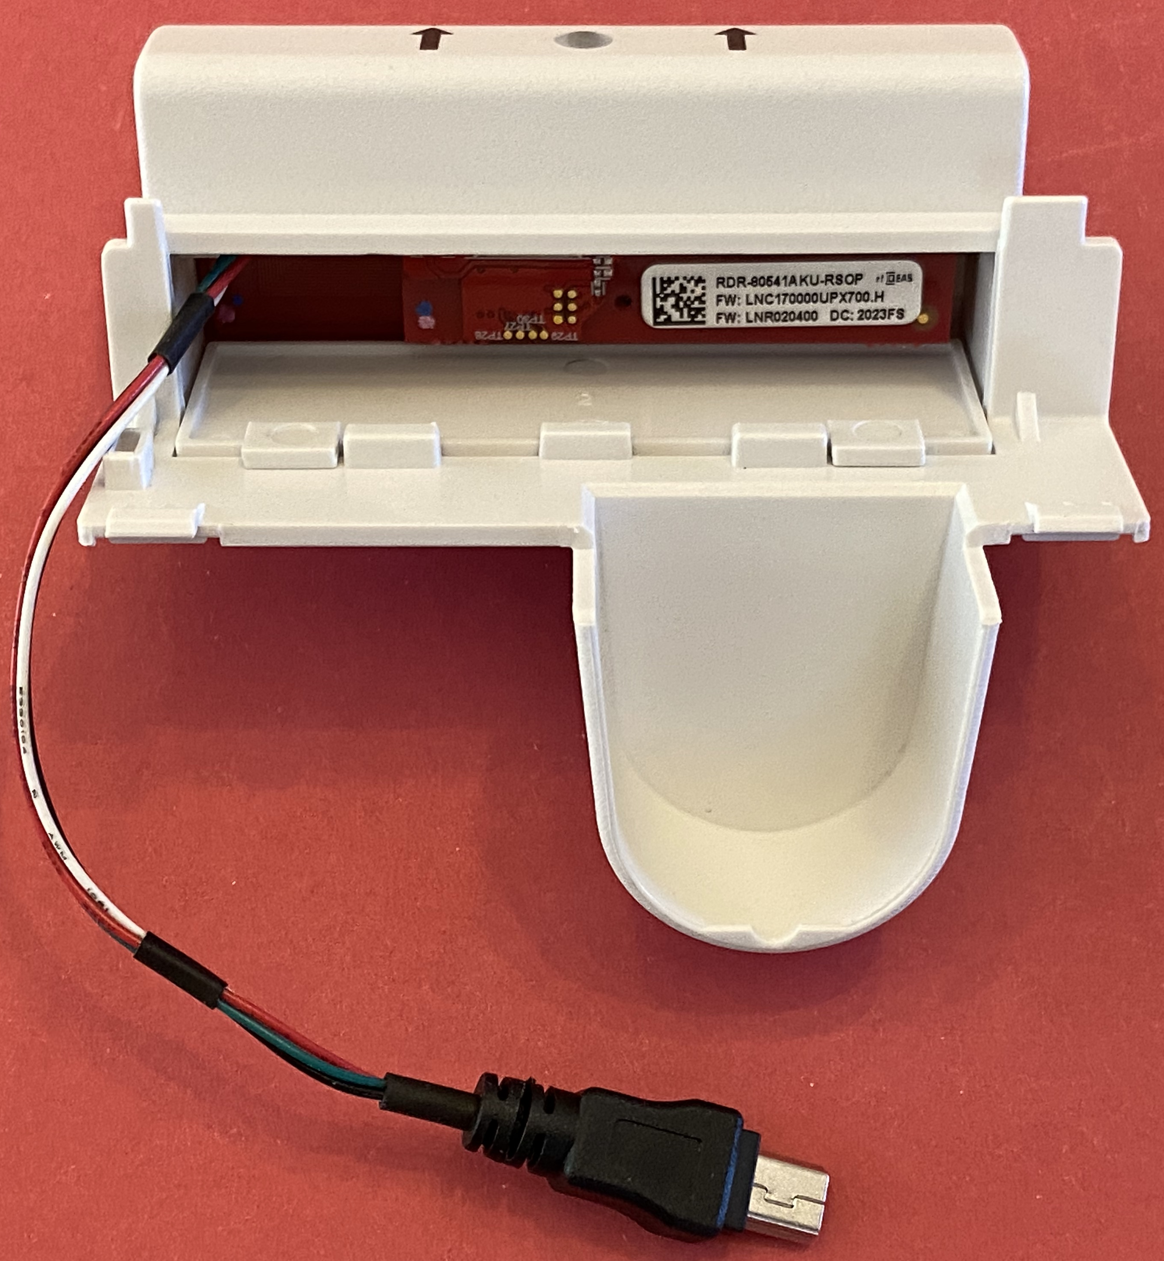
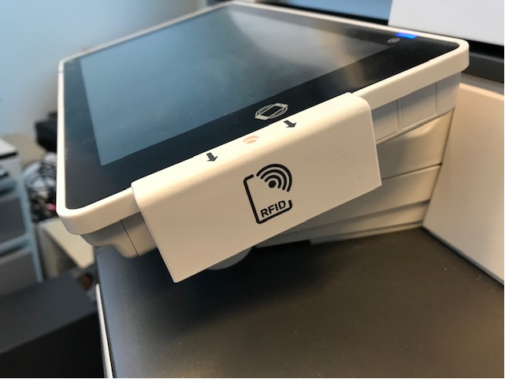

New WAVE ID® Ricoh Universal SOP Reader
The latest from rf IDEAS, designed specifically for Ricoh, the WAVE ID Ricoh Universal SOP reader delivers simple, secure authentication.
Snap-on, plug-and-play compatibility for Gen 2.5 SOP
  Seamlessly fits with A3 SOP (Gen 2.5) without impeding devices tilt range
  Fits A4 SOP (Gen 2.5) but with reduced vertical tilt range
Includes SAM slot to support support iCLASS® ID®/SE®/SEOS® or MIFARE® Secure Memory
Bluetooth integration supported with digital/mobile credentials
New WAVE ID Ricoh Universal SOP card reader models & SIM cards:
  RDR-80541AKU-RSOP (WAVE ID Plus RSOP)
  KT-80041AKU-RSOP (WAVE ID Plus RSOP w/ HID iCLASS® & SEOS® - incl. SIM card)
  RDR-80M41AKU-RSOP (WAVE ID Plus RSOP MIFARE Secure – incl. SIM card)
  RDR-30541BKU-RSOP (WAVE ID Plus RSOP Mobile BLE)
Projected Product Release:
September 2020
Notes:
Features/Benefits:
Designed for Ricoh’s Smart Operation Panel, providing a seamless, secure print solution
Snap-on, plug-and-play compatibility with Ricoh A3 and Ricoh A4 multifunction printers
Seamlessly fits the A3 printer’s second-generation G2 SOP side slot
Includes a Secure Access Module (SAM) slot to support iCLASS……Custom design offers ‘Integrated’ badge reader for new G2 A3 SOP
Clean installation without external cables
Snaps into A3 side pocket offering full panel tilt function
Short mini USB cable inside connects to internal port

Slide 4
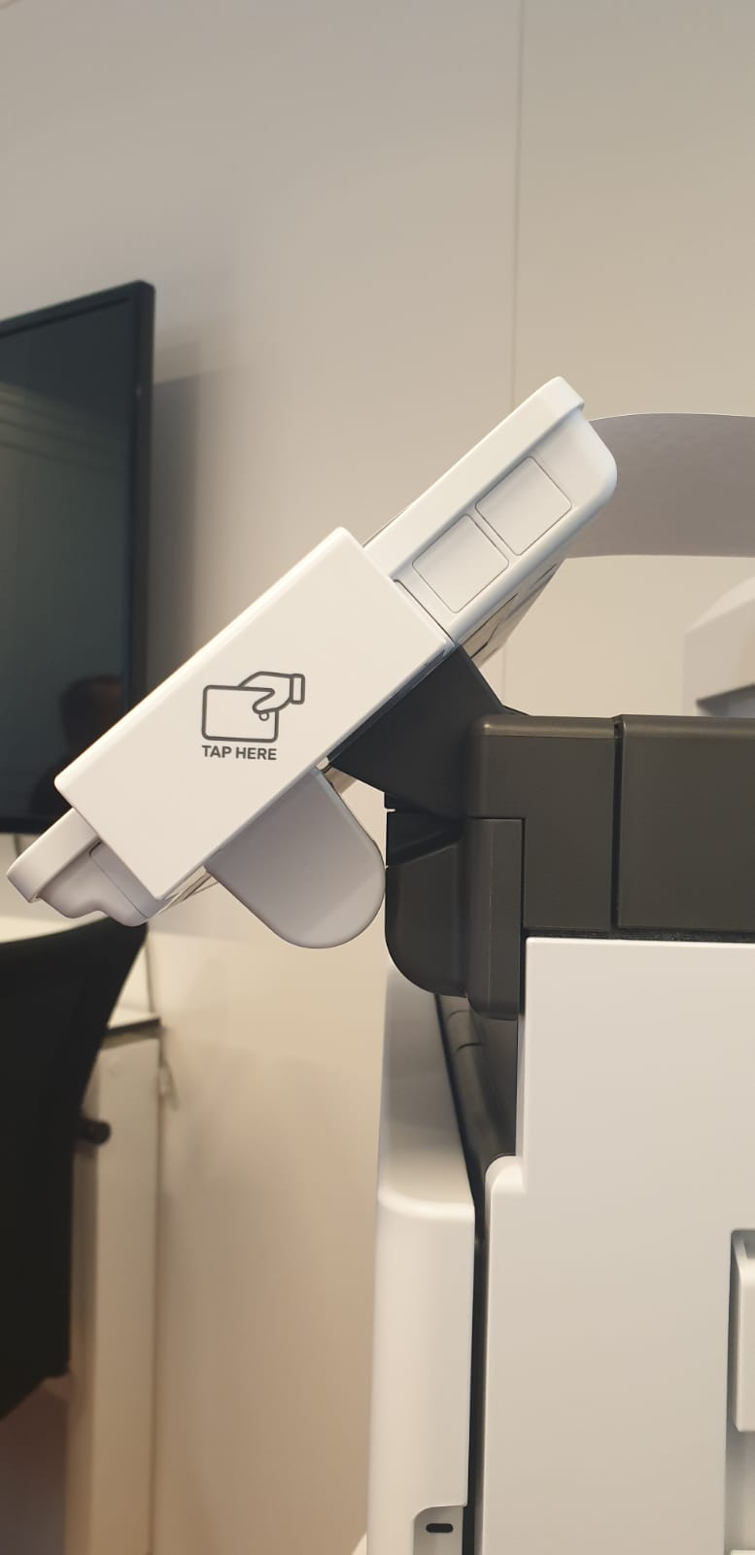
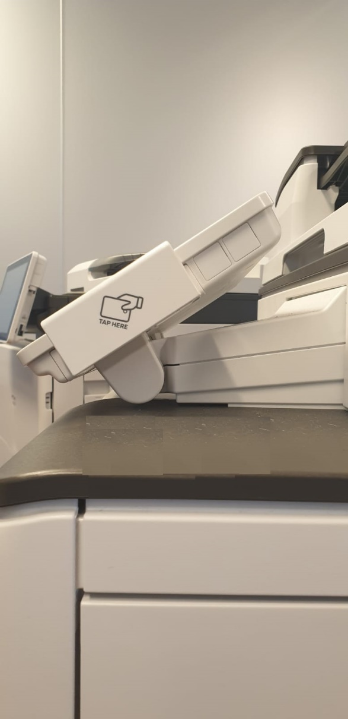
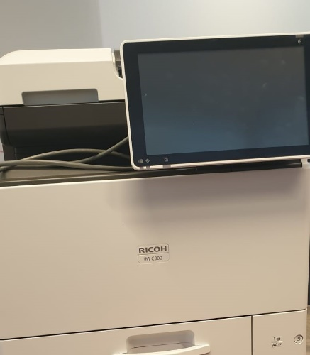
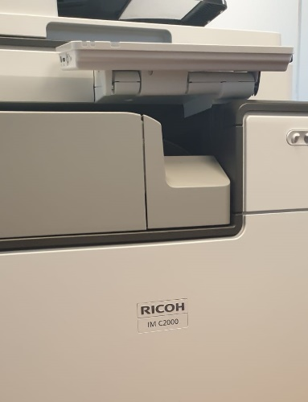
G2.5 SOP A3 –A4 Tilt Views
A4
Front view
A3
Front view
To Screen Horizontal position
To Screen Horizontal position


IM C400
To Screen vertical position
To Screen vertical position

Full Horizontal range.
Restricted Vertical
tilt range
Full Horizontal & Vertical
tilt range
available

Restricted
Side view
Side view

Slide 5
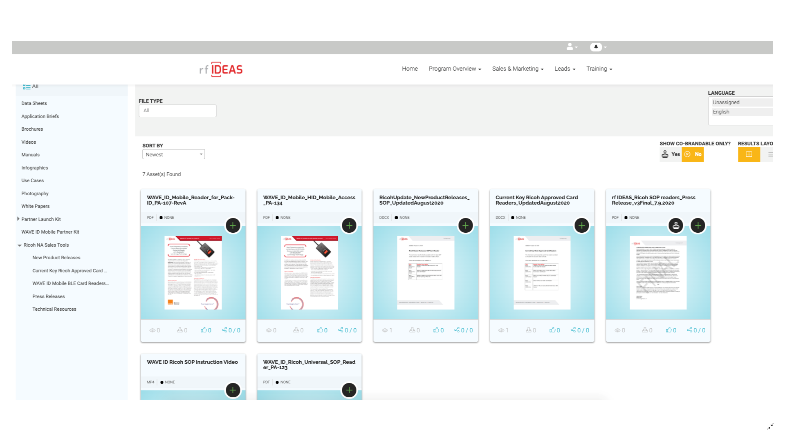
rf IDEAS ENGAGE Partner Portal
Ricoh page
rf IDEAS resources for Ricoh:
Marketing materials
  Product information
  Specification sheet
Training materials
  Installation video
  Access to Ricoh NA Sales Tools resources web page on ENGAGE portal:
  URL: https://partners.rfideas.com/prm/English/s/assets?collectionId=18445
  User ID: sales@ricoh-usa.com
  Password: Ric0hSales
(Note:
  0 in password is a ZERO.
  The password provided above should not be changed)
Notes:
Features/Benefits:
Designed for Ricoh’s Smart Operation Panel, providing a seamless, secure print solution
Snap-on, plug-and-play compatibility with Ricoh A3 and Ricoh A4 multifunction printers
Seamlessly fits the A3 printer’s second-generation G2 SOP side slot
Includes a Secure Access Module (SAM) slot to support iCLASS……Custom design offers ‘Integrated’ badge reader for new G2 A3 SOP
Clean installation without external cables
Snaps into A3 side pocket offering full panel tilt function
Short mini USB cable inside connects to internal port

Slide 6


Thank You!
Ashik Ramkalawon
Channel Account Manager
P: 224.386.0471
E: aramkalawon@rfideas.com
Jim Garlington
Director of Sales Americas
P: 224.386.0462
E: jgarlington@rfideas.com
Technical Support
Technical issues related to RF IDeas products
Toll-free: (866) 439-4884
P: (847) 870-1723
E: techsupport@rfideas.com
Sales Support
General and Sales questions
Toll-free: (866) 439-4884
P:(847) 870-1723
E: sales@rfideas.com
https://www.rfideas.com/
Connect with rf IDEAS

