Slide 1
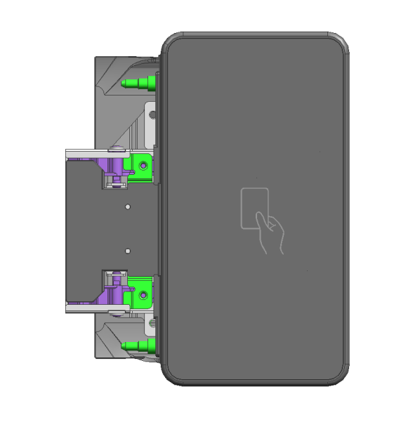
New Ricoh manufactured card reader holder for IM CXX10 models.
Part number 419413

Slide 2
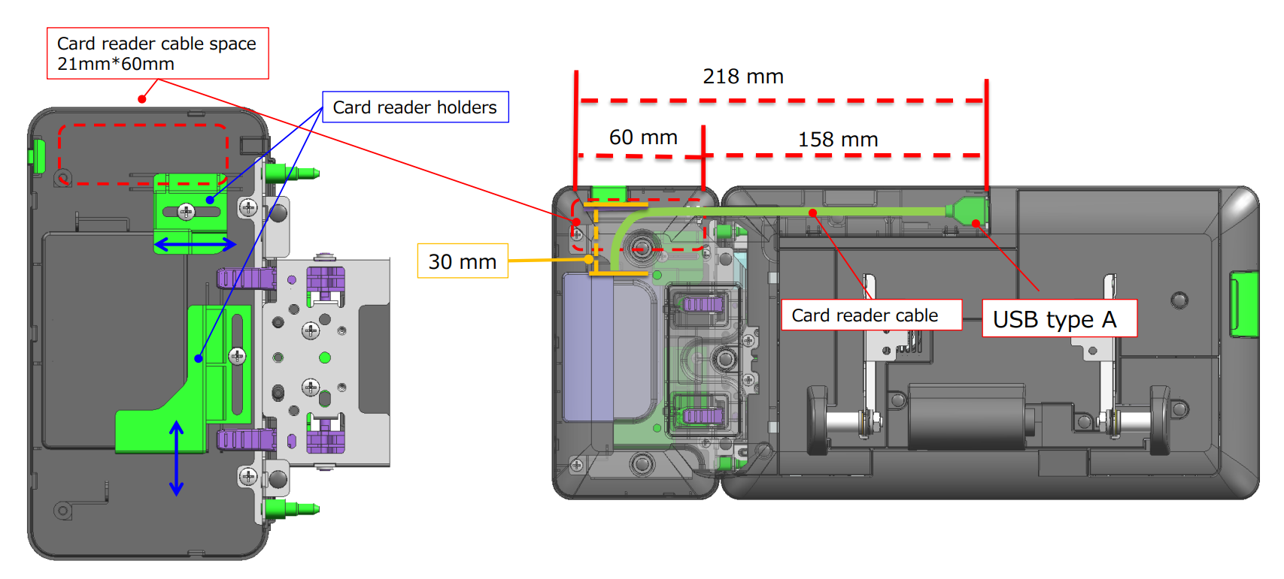
This is the new Ricoh Card reader holder EDP 419413 and the new smaller Elatec card reader. They are being shipped separately to Tina Cargile in Charlotte.

Slide 3
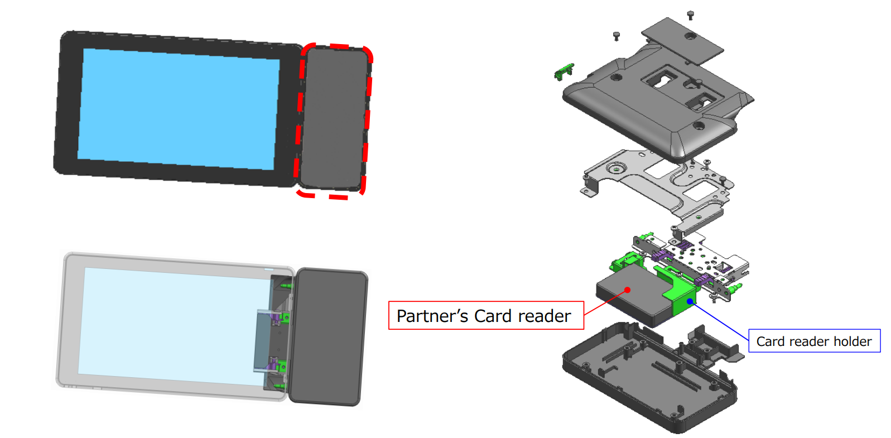

Slide 4
